Slide 1
HCI PROJECT
HIGH FIDELITY PROTOTYPE

Slide 2
TrafficTact APP

Slide 3
Interaction flow on how to behave at traffic signals
Helps you reach your destination safely without breaking any traffic rule
Users can learn basic traffic signals

Slide 4
Interface Design

Slide 5
We started by doing detailed analysis of Road safety in traffic signals
We came to solution of creating an app which is useful to public as well to the government.
We incorporated all the necessary patterns - Responsive design , Color style, sliders.
Many options are available for people and it is useful.
THE IMPORTANT TASKS THAT THE APP HANDLES IS :
Calls ambulance soon during emergency .i.e. It helps COP.
Police can valuate the traffic rules easily.
Police can easily generate challan in case of any punishable offense committed.
Civilian can learn about traffic rules easily and follow it.
Mainly there are 3 options in the app which will be known further.

Slide 6
KEY FEATURES
Awareness of Road Safety
Important signals included
It is helpful to both public and the government.
Mainly we have 3 options in this app - Civilian , Cop , Emt.
If we click Civilian we get the options about road safety and about traffic rules which has to be followed strictly.
If we click on EMT we get options it is severe or first aid. If it is severe ambulance will be called immediately otherwise first aid will be arranged.
Cop is all about safety rules to be followed.Useful to valuate rules.

Slide 7
Empathy Maps

Slide 8
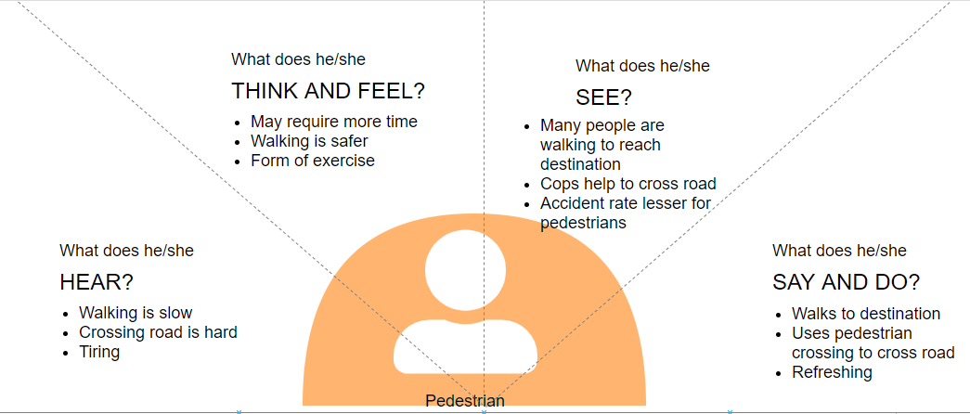
Pedestrian

Slide 9
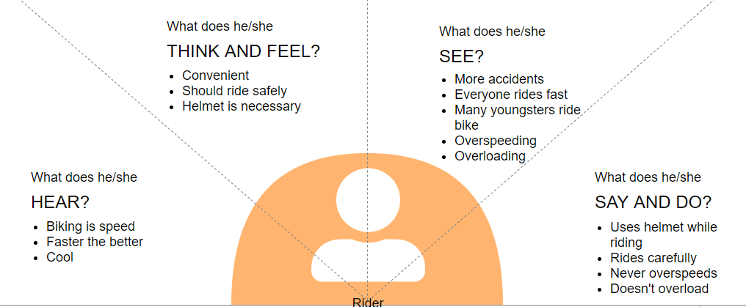
Rider

Slide 10
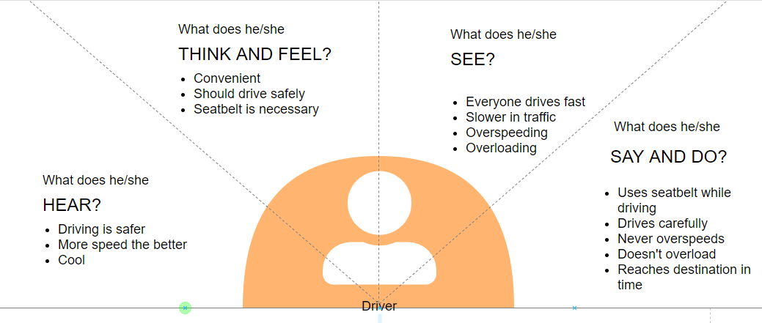
Driver

Slide 11
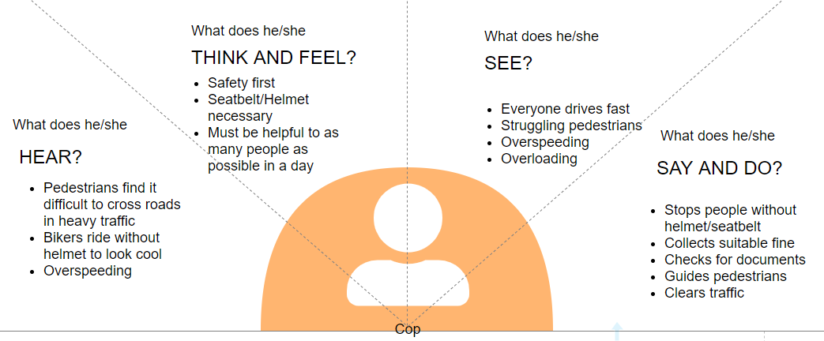
Cop

Slide 12
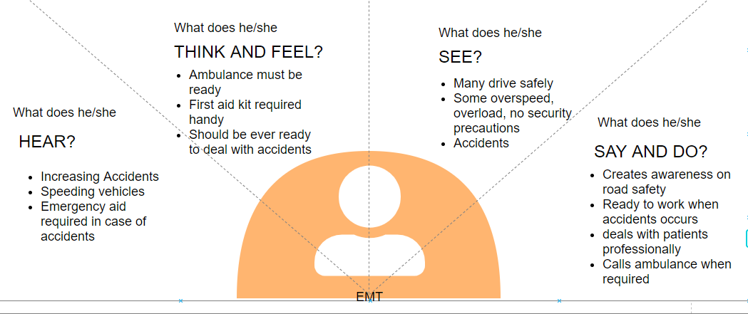
Emergency Medical Technicians

Slide 13
Screenshots of THE TRAFFIC TACT APP

Slide 14
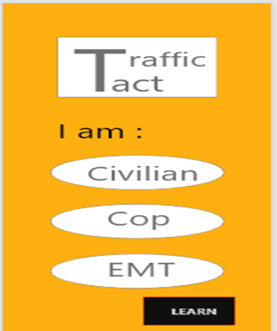

Slide 15
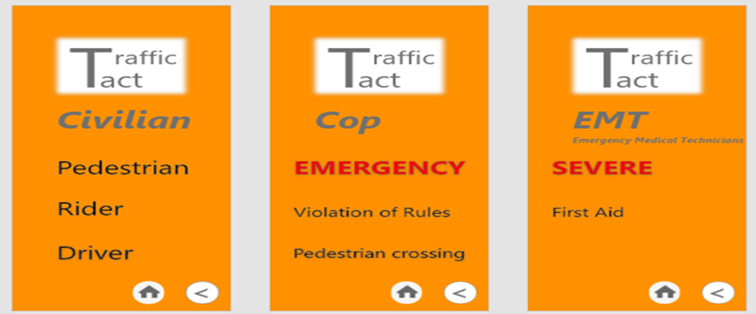

Slide 16
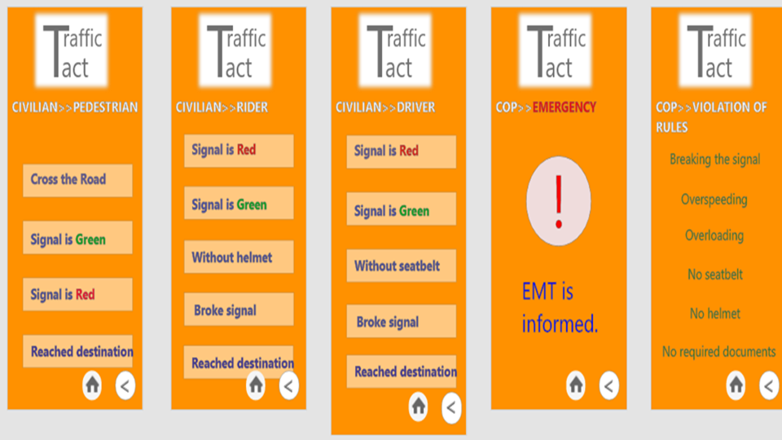

Slide 17
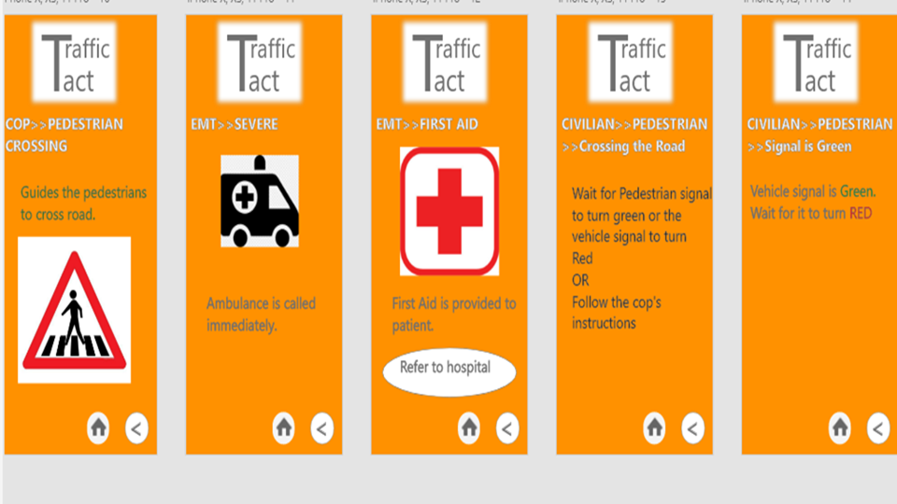

Slide 18
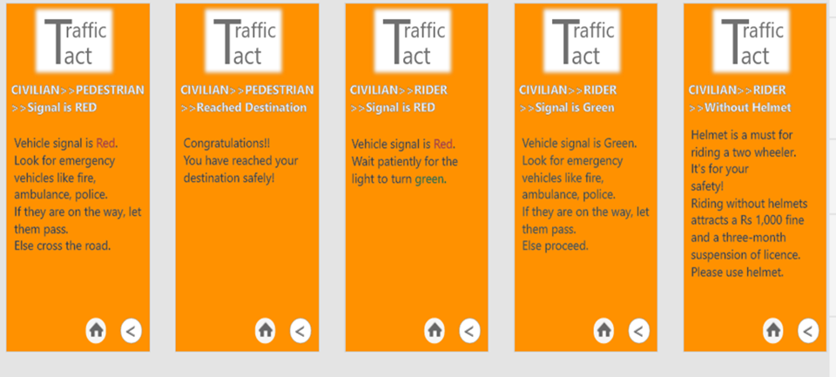

Slide 19
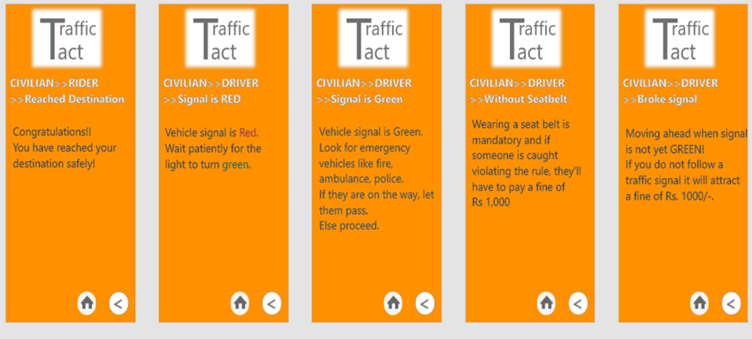

Slide 20
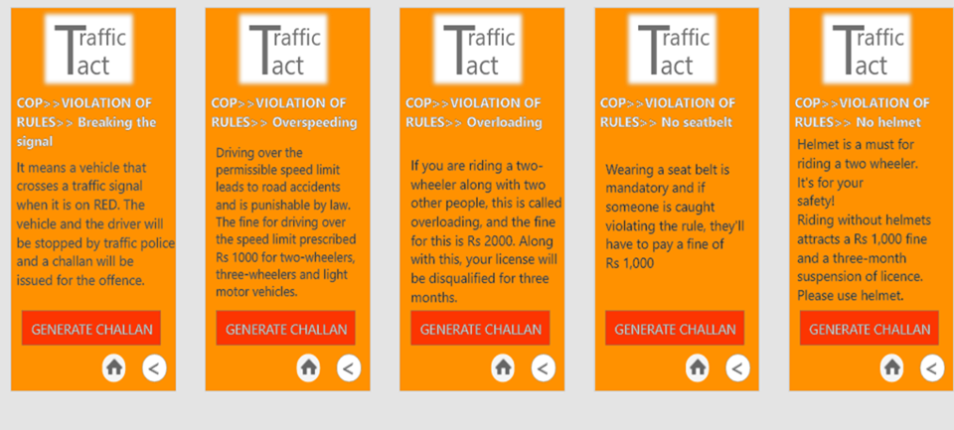

Slide 21
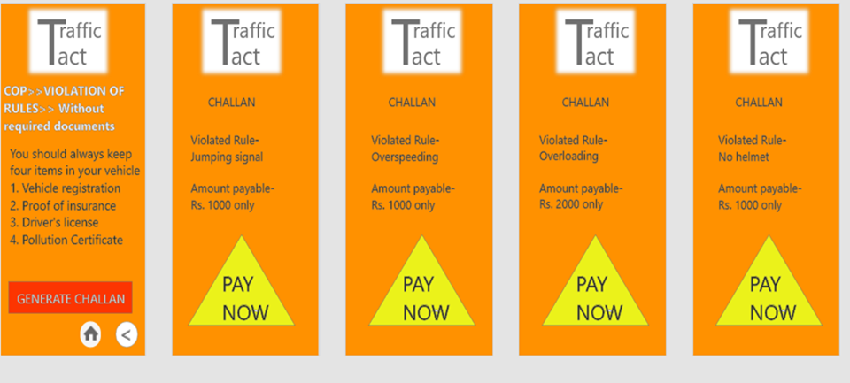

Slide 22
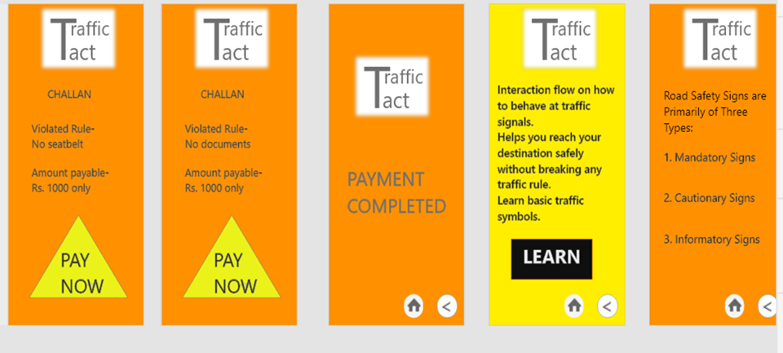

Slide 23
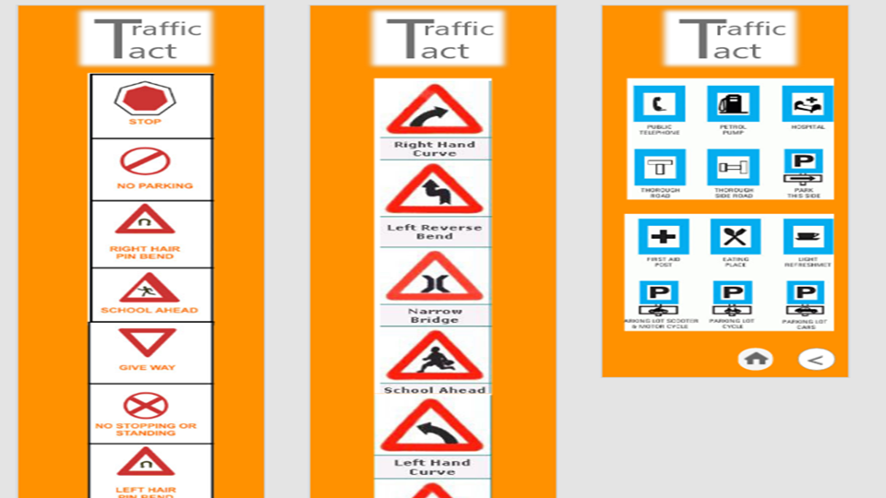

Slide 24
THANK YOU

